Slide 1
MPEG 4-LosSless audio coding
Pablo Domingo
Maria Gibert
CCAV – P18

Slide 2
INDEX
  Introduction
  Encoder
    Parcor Values
    Zero-pole unit circle diagram
    Quantify + Dequantify
    Parcor to LPC + Predictor
    Predicted waveform order 2, 8 and 12
    Golomb Rice Coding
  Decoder
    Golomb Rice Decoder
    Predictor
  Results

Slide 3
introduction
  MPEG-4 ALS: an Emerging Standard for Lossless Audio Coding by Tilman Liebchen and Yuriy A. Reznik.
  Many applications in recording and distribution of audio → Studio operations, collaborative work or music distribution over the Internet, etc.
  Standard introduced in March 2003
    Objectives:
      Provide lossless reconstruction of PCM audio signals at different sampling rates and word lengths
      Achieve superior compression efficiency to other algorithms
      Provide means for editing, manipulation and random access to the compressed audio

Slide 4
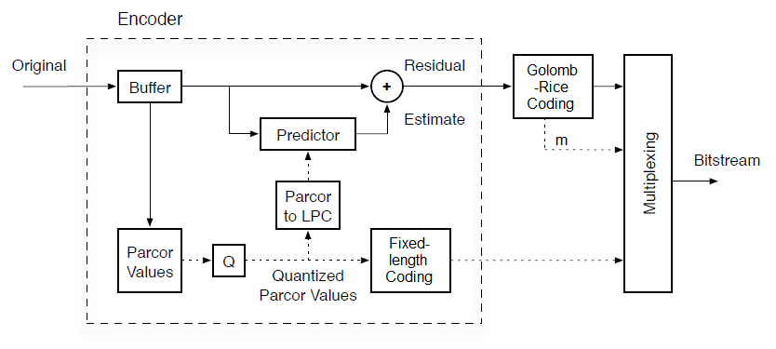
encoder

Slide 5
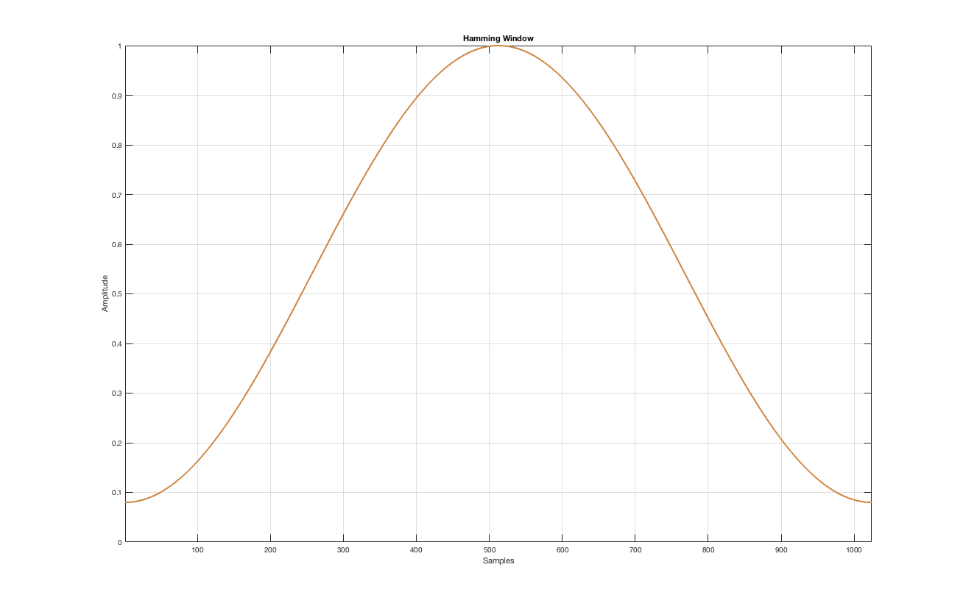
Parcor values
  Apply Hamming window to each frame
  Calculate the autocorrelation order p
  Levinson – Durbin algorithm to estimate PARCOR VALUES (k) using windowed frame
    Initialization
    R(0) = R(0)*257/256 → to stabilize the predicted values
    Iterate

Slide 6
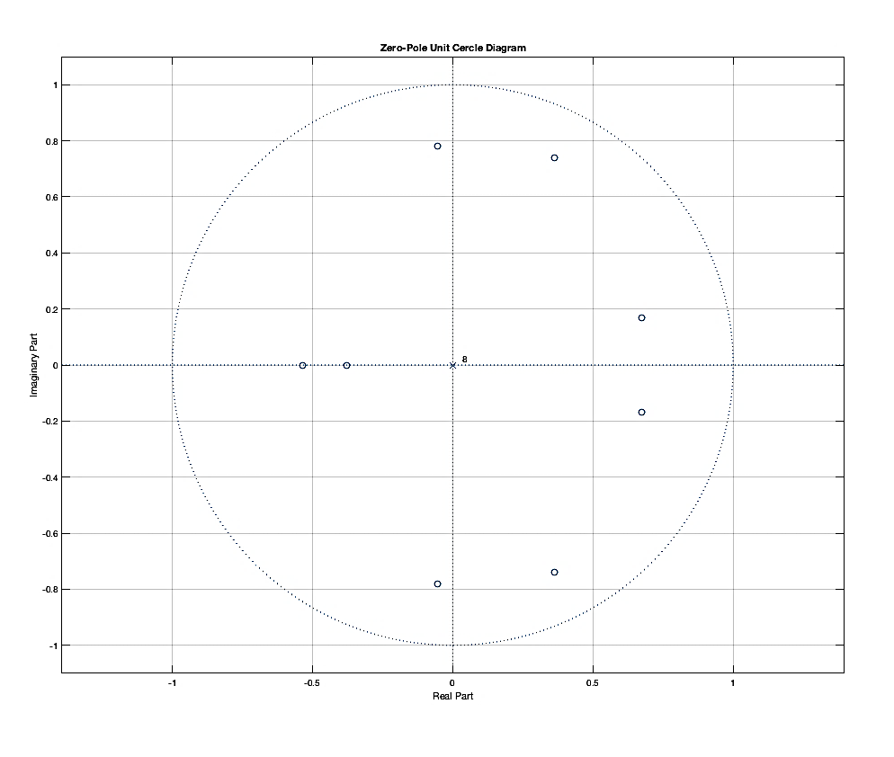
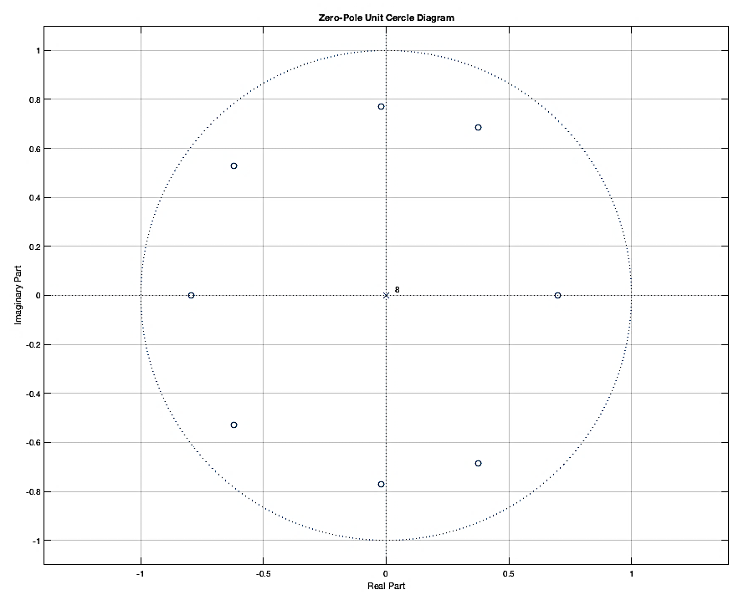
Zero-pole unit circle diagram
Non stabilized coefficients
Stabilized coefficients

Slide 7
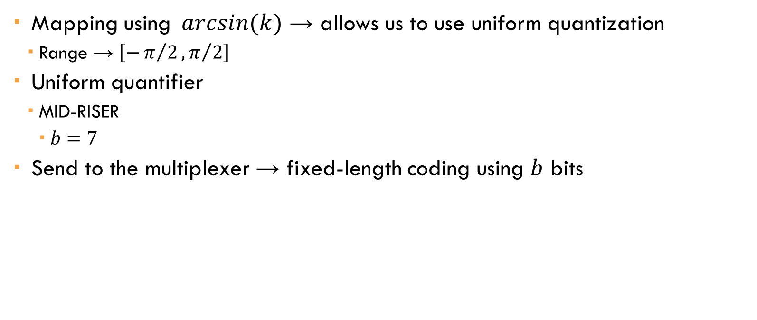
QUANTIFY + DEQUANTIFY
  Mapping using $⁡arcsin(k)$ → allows us to use uniform quantization
    Range → $\left[−π/2,π/2\right]$
  Uniform quantifier
    MID-RISER
      $b=7$
  Send to the multiplexer → fixed-length coding using $b$ bits

Slide 8
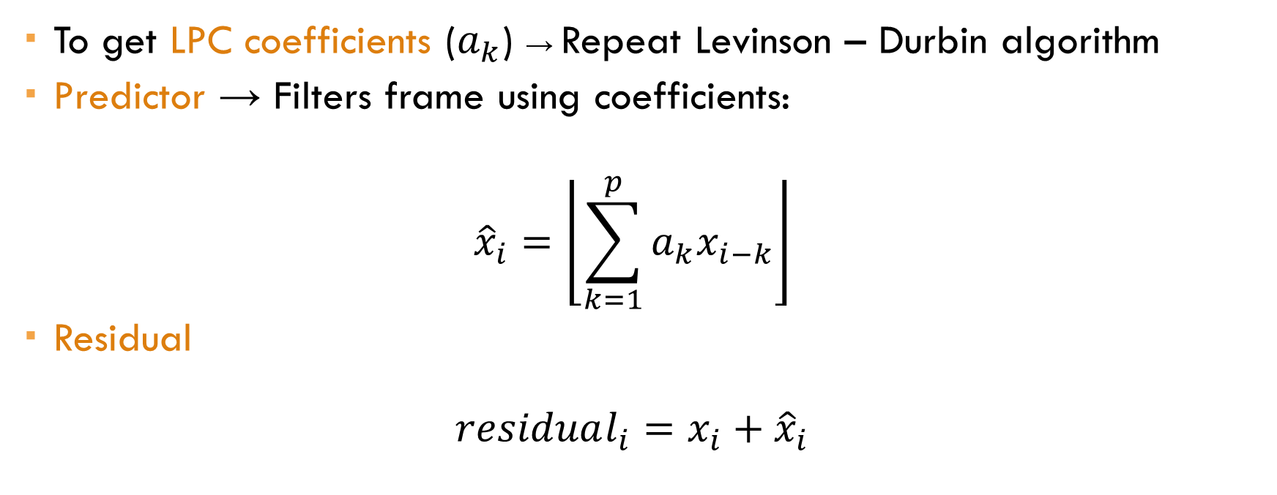
Parcor to lpc + predictor
  To get LPC coefficients ($a_{k}$) → Repeat Levinson – Durbin algorithm
  Predictor → Filters frame using coefficients:
  $${\hat{x}}_{i}=\left\lfloor \sum_{k=1}^{p}{a_{k}x_{i−k}}\right\rfloor$$
  Residual
  $$residual_{i}=x_{i}+{\hat{x}}_{i}$$

Slide 9
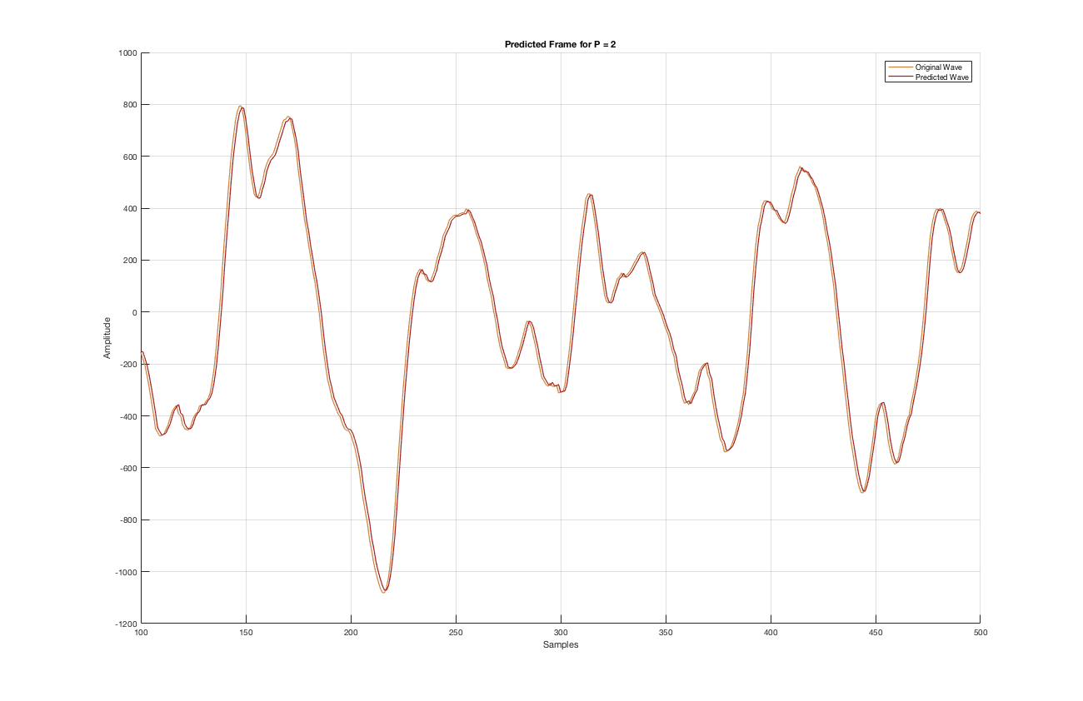
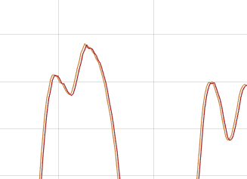
Predicted waveform – ORDER 2

Slide 10
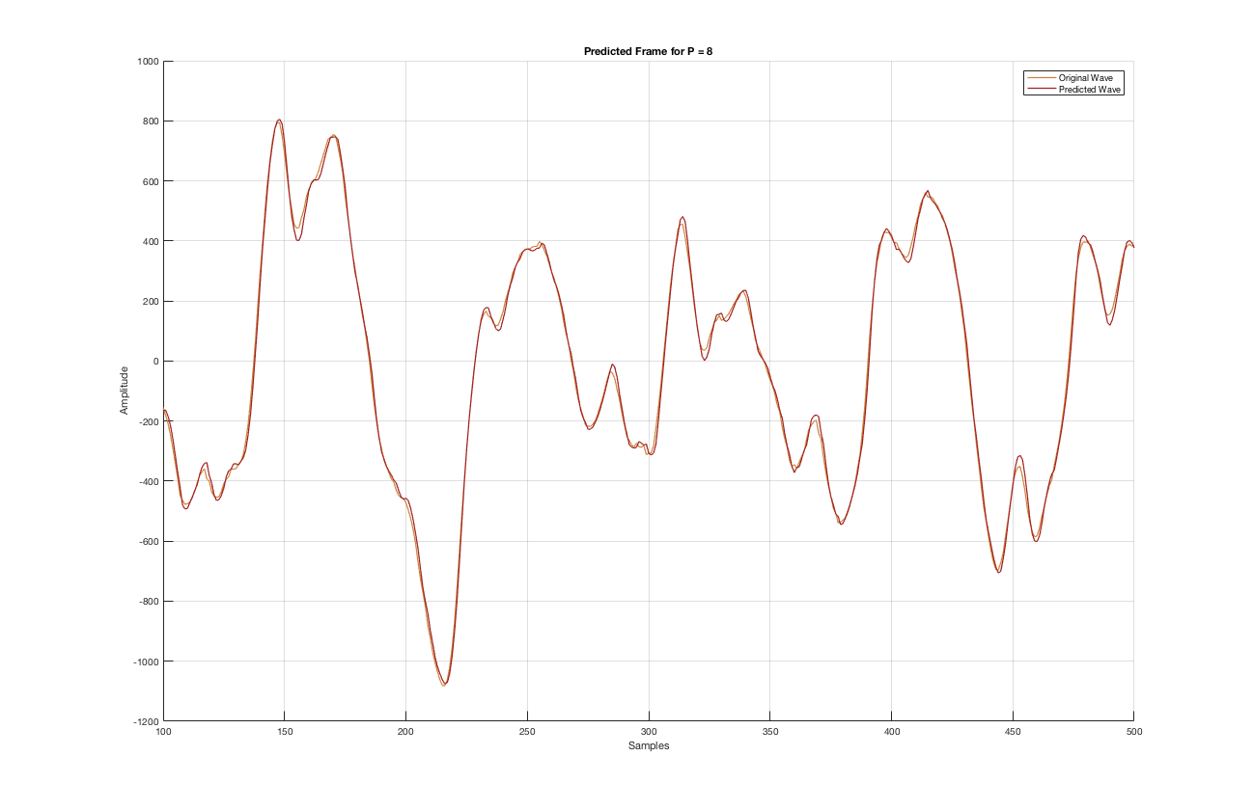
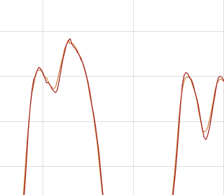
Predicted waveform – ORDER 8

Slide 11
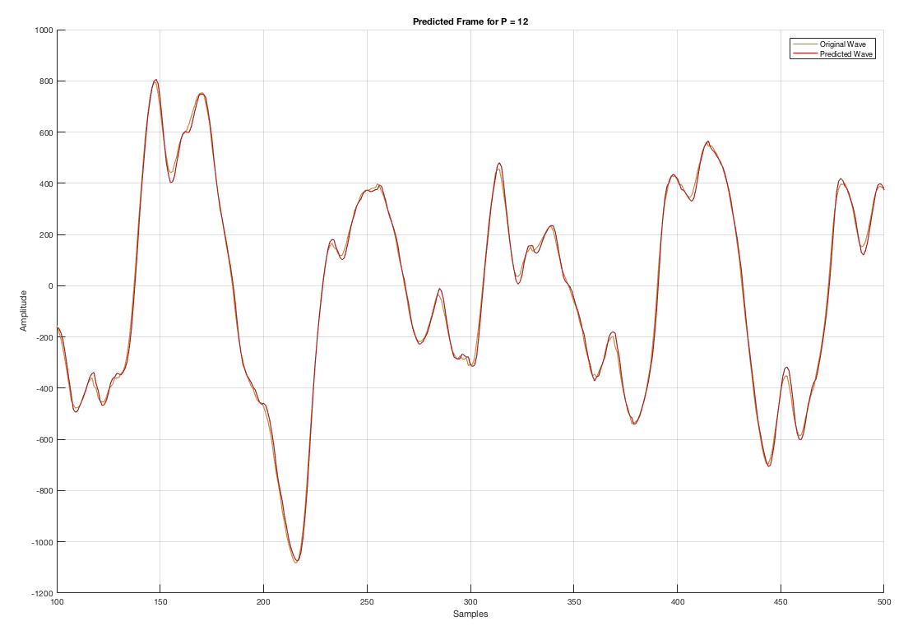
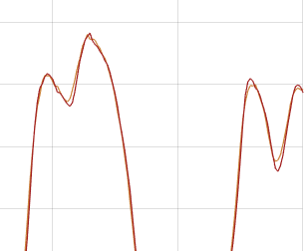
Predicted waveform – ORDER 12

Slide 12
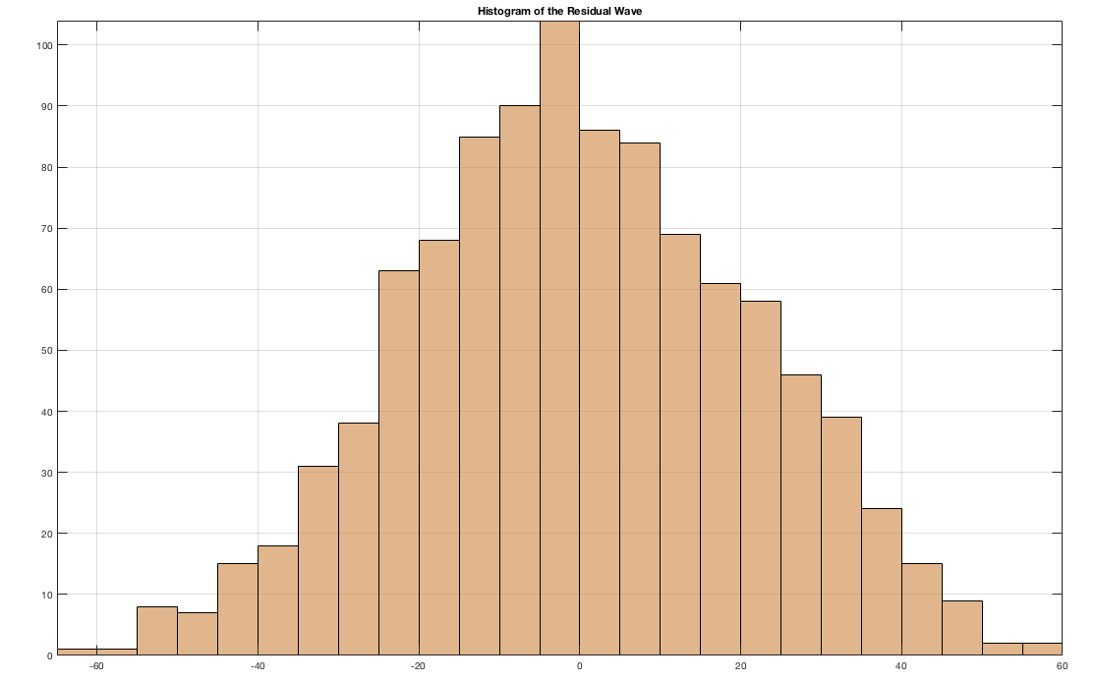
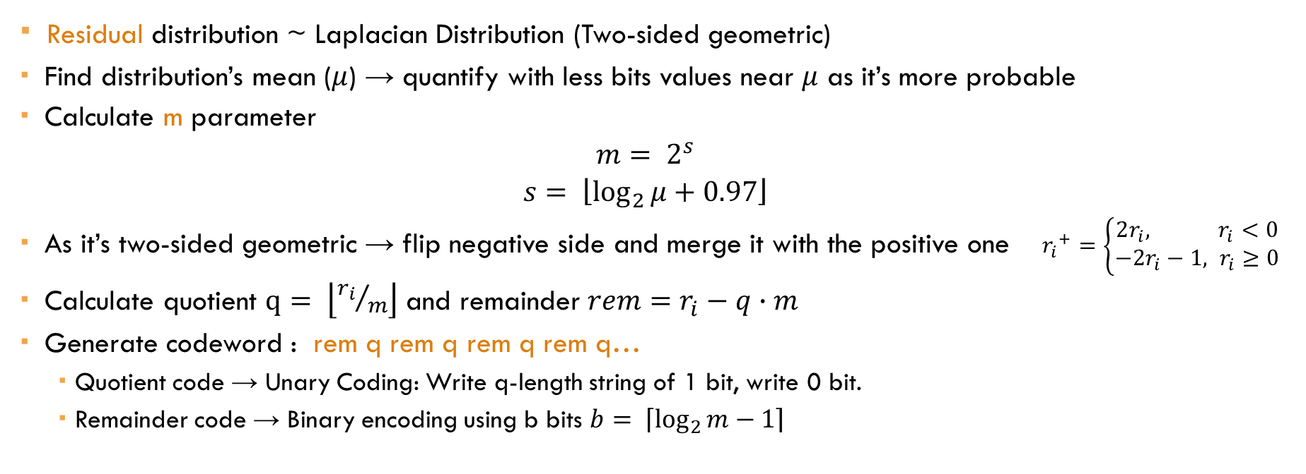
Golomb-rice coder
  Residual distribution ~ Laplacian Distribution (Two-sided geometric)
  Find distribution’s mean ($μ$) → quantify with less bits values near $μ$ as it’s more probable
  Calculate m parameter
  $$m= 2^{s}$$
  $$s= \left\lfloor \log_{2}{μ}+0.97\right\rfloor$$
  As it’s two-sided geometric → flip negative side and merge it with the positive one ${r_{i}}^{+}=\left\{\begin{aligned}2r_{i}, r_{i}<0 \\ &−2r_{i}−1, r_{i}≥0\end{aligned}\right.$
  Calculate quotient $q= \left\lfloor {r_{i}}/m\right\rfloor$ and remainder $rem=r_{i}−q∙m$
  Generate codeword : rem q rem q rem q rem q…
      Quotient code → Unary Coding: Write q-length string of 1 bit, write 0 bit.
      Remainder code → Binary encoding using b bits $b= \left\lceil \log_{2}{m−1}\right\rceil$

Slide 13
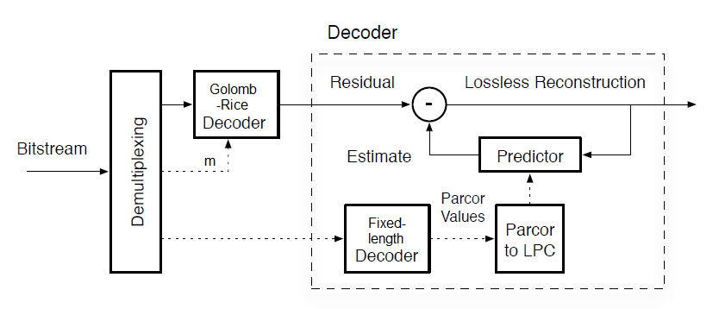
decoder

Slide 14
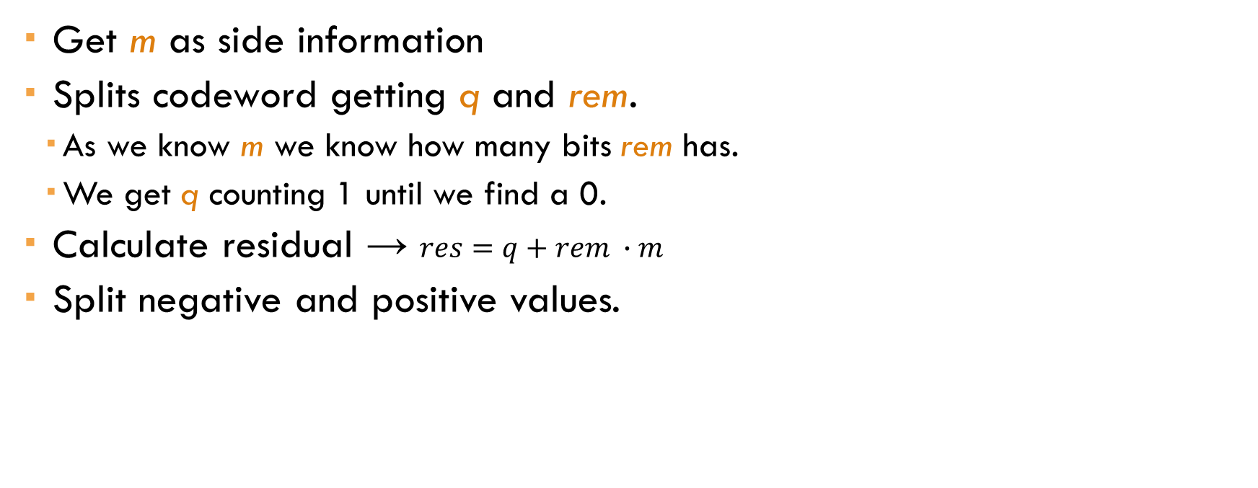
GOLOMB-RICE DECODER
  Get m as side information
  Splits codeword getting q and rem.
    As we know m we know how many bits rem has.
    We get q counting 1 until we find a 0.
  Calculate residual → $res=q+rem ∙m$
  Split negative and positive values.

Slide 15
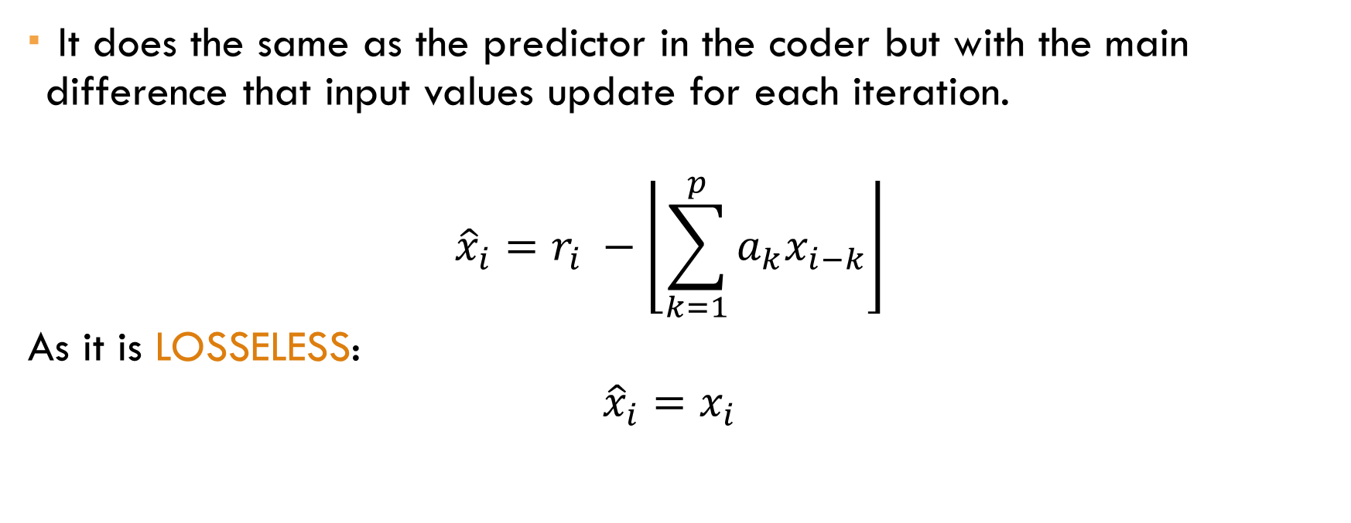
Predictor
  It does the same as the predictor in the coder but with the main difference that input values update for each iteration.
  $${\hat{x}}_{i}=r_{i} −\left\lfloor \sum_{k=1}^{p}{a_{k}x_{i−k}}\right\rfloor$$
  As it is LOSSELESS:
  $${\hat{x}}_{i}=x_{i}$$

Slide 16

results
  Fragment:
  You Are The Sunshine Of My Life
  Stevie Wonder

Slide 17
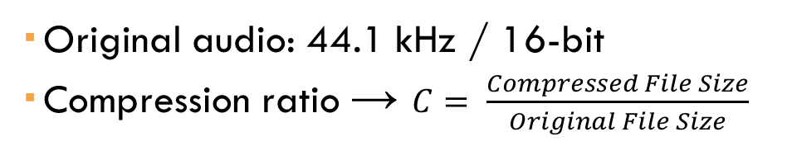
results
  Original audio: 44.1 kHz / 16-bit
  Compression ratio → $C= \frac{Compressed File Size}{Original File Size}$

Slide 18
Any questions?
Thank you

